Slide 1


Child Protection Information Management System-Kenya
Case Management Workshop
4-6 December, 2019
Presenters:
Polycarp Otieno
Joseph Mugah

Slide 2

Outline
Aim
Objective
Problem Statement
Design
CPIMS-How it works
Targeted users
Integration
Achievements
Lessons learnt

Slide 3
Aim
A comprehensive information management system that:
1. Provides accurate, timely and consistent national data for evidence-based programming on children protection issues and be able to track the services provided to a child across all service points.
2. Encompasses all processes from use of individual pieces of data for case management to the generation of reports
3. Information management system linked to other key data management systems
Notes:
A comprehensive information management system linked to other key data management systems to :
provide accurate, timely and consistent national data for evidence-based programming on children protection issues and be able to track the services provided to a child across all service points.
encompass all processes from use of individual pieces of data for case management to the generation of reports and dashboards
National Plan of Action for Children in Kenya 2015

Slide 4
Objectives
Facilitate monitoring and evaluation of child protection interventions
Enhanced access to accurate, timely and reliable aggregate data
Facilitate record keeping and information management on individual case records
Track vulnerable children longitudinally and geographically
Facilitate appropriate information sharing
Provide a software system which is flexible, extensible & scalable over time
Notes:
Objectives
Facilitate monitoring and evaluation of child protection interventions in Kenya, in order to inform policy and evidence based decision making
Provide access to accurate, timely and reliable aggregate-level child protection data
Facilitate record keeping and information management on individual cases of child protection
Track vulnerable children longitudinally and geographically to ensure continuity of care and protection, including children in institutional care
Facilitate appropriate information sharing between stakeholders and service providers so that any interventions undertaken will support the best interest of the child
Provide a software system which is flexible & extensible over time to cater for emerging needs in the children sector

Slide 5
What it was created to solve:
Lack of functional national child protection IMS that can provide statistics:
a).The national level:
  Performance Monitoring
  informing and providing justification for budgeting decisions and
  Meeting reporting requirement at the national, regional and international levels.
  Data sharing at international forums and other agencies
  Data review and routine reports, information product and policy formulation

Slide 6
What it was developed to solve
b)The county and sub-county level:
Sharing data with child protection stakeholders
Reporting to external administrative partners like the area advisory council
Performance Monitoring
Supporting effective individual case management, referrals and reporting requirements
Partners and stakeholder coordination and accountability
Data collection, management and ownership
Data Quality

Slide 7
Design
Hybrid of online transaction processing (OLTP) and online analytics processing (OLAP)
Design approach on open standards and open sources applications.
Developed in Python Django framework on a PostgreSQL back end.
Consist of two main instances, for the Department of Children services and OVC IPs.
Web-based for development, training and production.
Modular development approach to allow for both vertical and horizontal scalability.

Slide 8
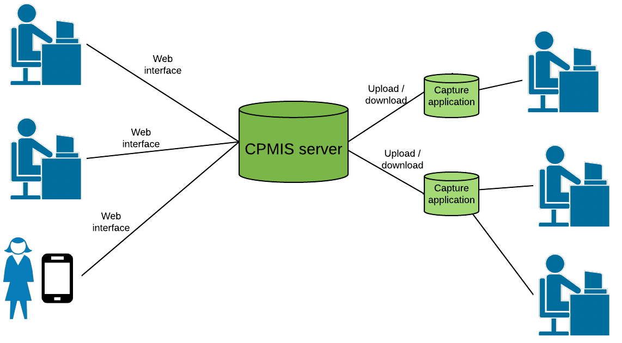
CPIMS Deployment

Slide 9
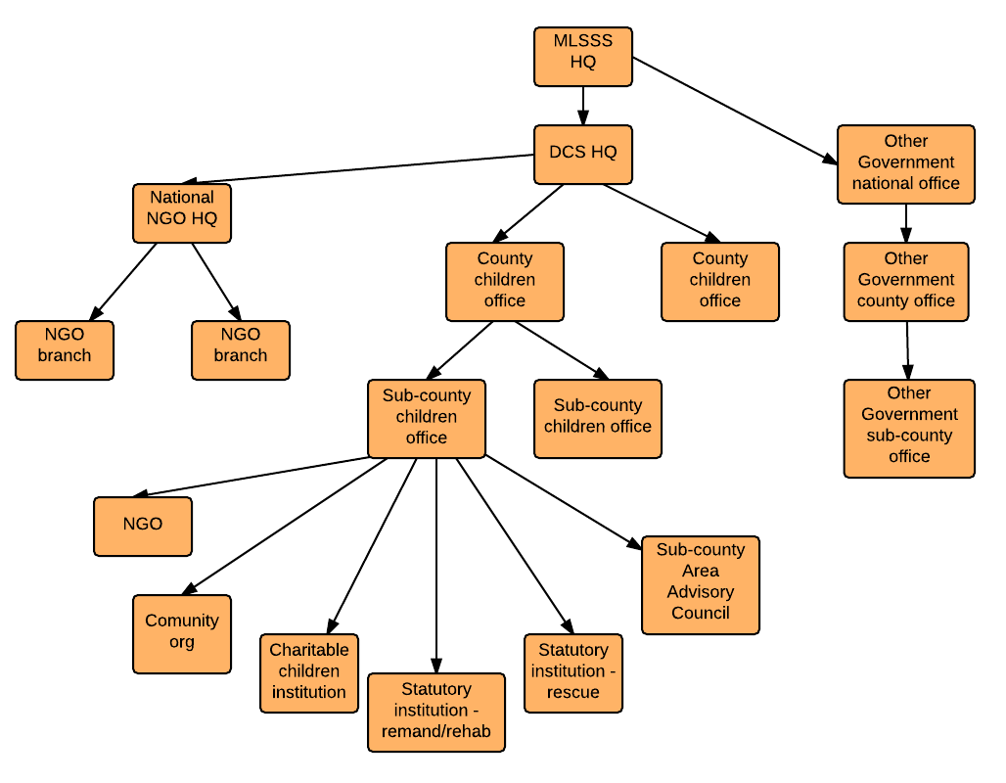
Managing Stakeholders & users
Notes:
Cascade approach – easier maintenance of registries of org units and users

Slide 10
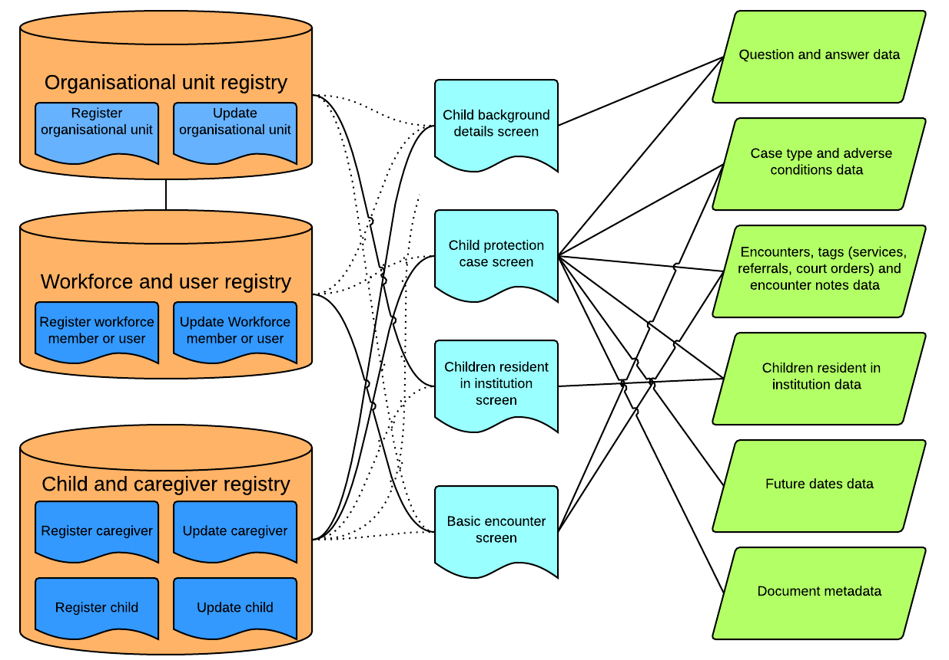
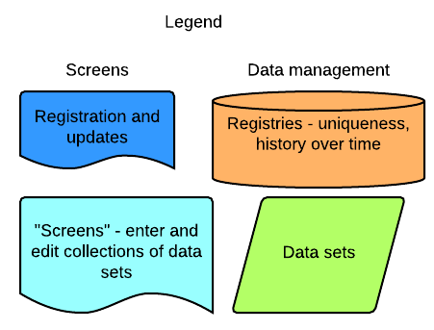
Persons Registry
Meta Data
Persons Registry

Slide 11
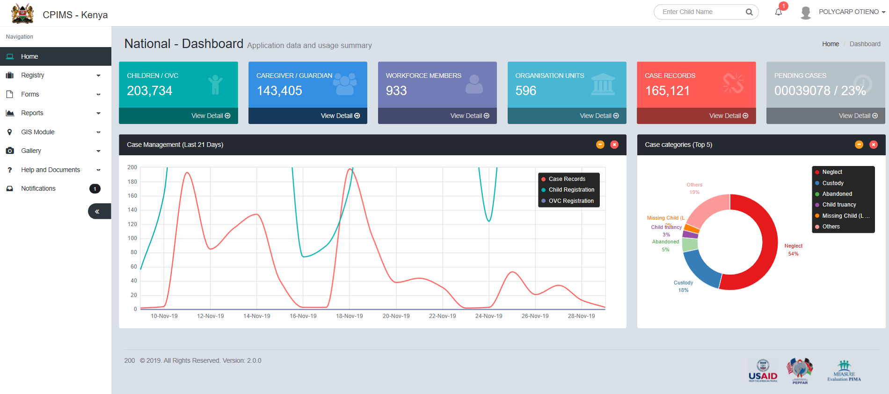

Slide 12
How it works - System
Meta data
Registration
Case Management
Geo-Information,
Facilities&
Schools
Organization Unit
Persons Registry
  Workforce,
  System Administrators,
  Care-givers/Guardians,
  Child/OVC: Registration, Case Details/Eligibility Criteria,
1.Case Follow ups,
2.Service Provision,
3.Well-being,
4.Case Plans,
5.HIV Management,
6.HIV Risk Screening,
7.Case Closure

Slide 13

How it works-Programming
DCS
Case Reporting
-Community/
Caregiver/VCO/
OVC
Enrolment
Service Provision
-Assessments and tracking
Case Creation
-Case Record Sheet
Case Plan Achievement Monitoring
Well being Assessment
Case Follow up
-Summons/Referrals
Case Plan Development
Case Closure
-Transfers/Exits/ Graduation
Case Closure

Slide 14
Data Collection Documents
Case record sheet
Case register
Institutional placement
and follow up
Alternative family care
School Bursary Form
Follow up forms
Social inquiry
OVC Case Management
Enrolment form
Wellbeing (Child & Caregiver)
CPARA
Case Plan
Service Provision (Child & Caregiver)
Health Management:
  HIV Risk Screening
  HIV Management
Case Closure

Slide 15
Rollout Process
1
Undertake stake-holder mapping and analysis
2
Conduct an ICT/individual capacity assessment
3
Sensitization of DCS revised tools and the reporting guidelines
8
4
5
7
6
Procure ICT Equipment
System Deployment
Conduct User Training
Conduct site visits for Mentorship
Conduct Quarterly Data Reviews
Notes:
Process/Step
Stakeholder mapping and analysis
A list of child protection players, their locations and thematic areas of service.
Improved coordination of child protection activities
Increased capacity of DCS to coordinate all CP activities at all levels
Increased use of evidence in allocation of resources
Improved interaction between all CP stakeholders at all levels
Improved role for DCS in monitoring and supervision of quality of service provided to children in need
CPIMS startup meeting
One-day sensitization at county level bringing together the DCS and selected stakeholders in CP
A forum for disseminating DCS reporting tools and guidelines
An assessment to understand the field challenges unique to each county that may hinder the full realization of the expected implementation of DCS reporting guidelines. Forum for field staff to provide solutions that work for them.
Introduce the concept of data for decision-making and role of field staff in using data for decision making
ICT infrastructure audit & capacity assessment
Inventory of ICT infrastructure provided to the Sub county and county children offices
An informed basis for equipment purchase and training requirements
An assessment of the site’s capacity to work with the live CPIMS
ICT inventory rationalization, purchase and distribution of equipment
Rational identification of gaps and needs in ICT equipment deployment based on available resources
Improved equity in the allocation of ICT resources in order to increase the number of offices with the basic minimum package of ICT equipment
Availing equipment that meets the GOK standards and the sites are able to maintain
CPIMS end-user training
A wide base of staff able to interact with CPIMS across all frontline service providers
Improved working skills on CPIMS and other DCS reporting tools
Action plan and follow-up for capacity building initiatives
Development of post-training action plans to increase engagement of other staff partners in CPIMS use
Development of a CPIMS suitability action plan at the sub counties and counties
Identification of CPIMS champions
Champions with the right aptitude and ability to correctly manipulate CPIMS and articulate DCS business process
Develop a pool of CPIMS champions to support in training and long-term mentorship for the CPIMS
CPIMS post-training user follow-up
Improved end-user skills post-training
Improved confidence for users to transit to the live CPIMS
Helpdesk through WhatsApp Group for users to exchange info
CPIMS readiness index for the counties and sub counties
CPIMS startup (live system)
All end-users are migrated to the live system
All CP officer and stakeholders have login credentials
First login and case entry into the system.
Mentorship
CPIMS mentorship visits by the county and HQ
Improved competence in use of CPIMS
Entry of quality data in CPIMS
Availability of usage statistics for monitoring of system use
Baseline RDQA and Performance Improvement Plans
Quarterly data quality assessment in all CPIMS counties
SMART action plans on data quality improvement at the sub counties
Data demand and use (DDU)
Fully adopted DDU framework for CPIMS and CP
Develop a guideline for the data use at all levels of CP service delivery
Identify opportunities for data use in decision making at both National and sub national levels

Slide 16
Targeted users
Department of Children Services Headquarter staff
Sub-county and county level Children officers
Statutory Institutions managers and staff
Charitable children institutions staff
OVC program implementers (Implementing partners and LIPs)
Other NGOs providing child protection and welfare services
Voluntary Children Officers supporting sub county offices

Slide 17
Integration
Referrals for interventions : Judiciary, NHIF, SI
Integration with other systems: 116, VURUGU mapper
Health (Kenya Master Facility Database and Viral Load/EID Database)
Judiciary – on going
Schools NEMIS system – yet to start

Slide 18
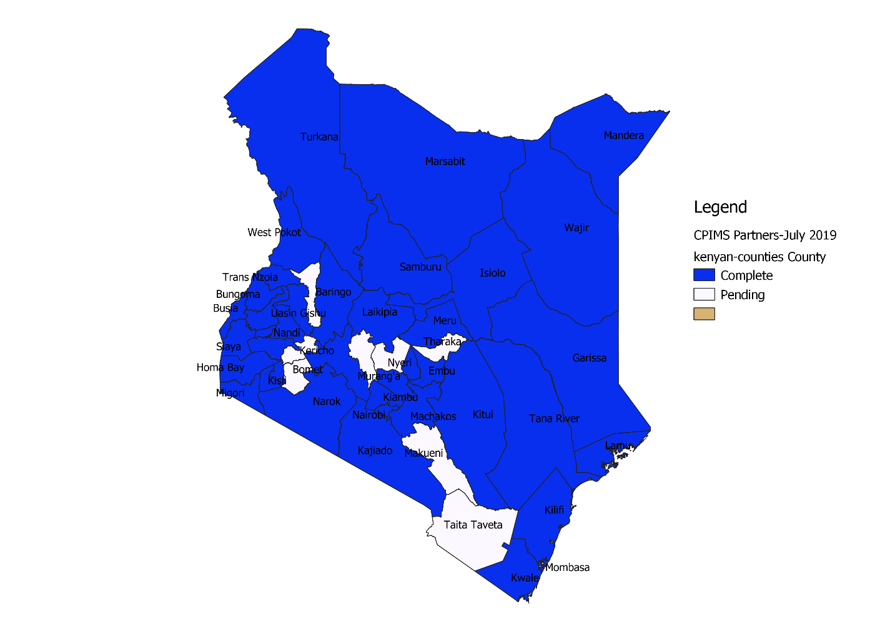
Achievements
Incremental development
  Presidential Bursary
  Alternative Family Care
  Counter Trafficking in Persons
  Case Categories
Phased roll out
  Piloted 3 counties
  Rolled out to initial 15 counties
  Rolled out to another 25 counties
  Targeted all counties by end of year
  Rolled out to all the 31 Statutory institutions
  Rolled out to all USG OVC Implementing partners
Notes:
The system has been deployed in 43 out of 47 counties. Will have been rolled out to all the counties by end of the year. Training of last 4 counties currently underway. Government looking to transition all reporting to be through the system by end of March 2020.

Slide 19
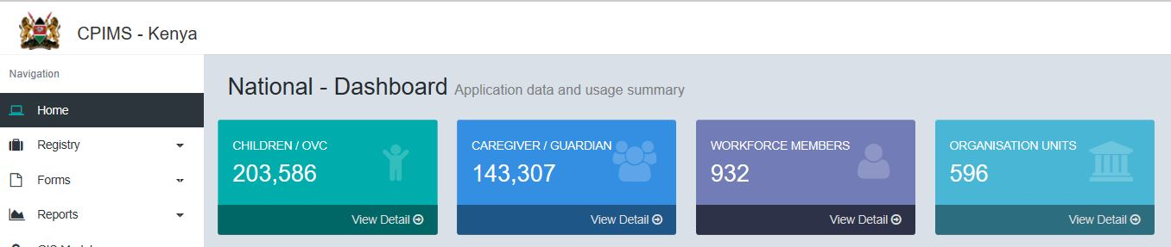
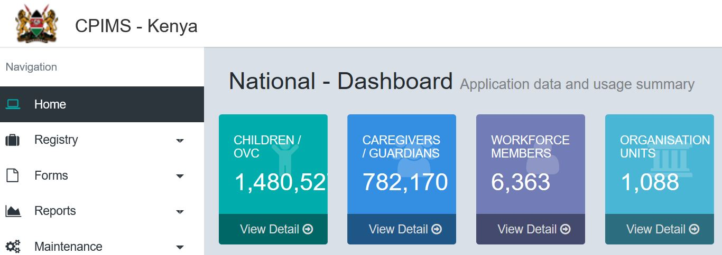
Achievements
Capacity building initiatives
  Trained in CPIMS use DCS-865 OVC IPs-2067
  Trained 105 DCS staff in data analytics and use
  Sensitization on data quality assurance activities
Increased data availability

Slide 20
Lessons learnt
Leadership: Technical Working Group and steering committee
Ownership and Support : Government owned, led and supported
Diverse business processes
Competing and non-aligned partners priorities
Lack of national level unique identifiers for children and caregivers
Notes:
The CPIMS system from inception, development and roll out, the partners has ensured that it has remained government owned, government led, and supported. This has ensured that government has remained central to the development and evolution of the system
Stakeholder engagement – The process has been all inclusive with a TWG that supports the technical work, steering committee to oversee the vision and resources mobilization and ICT task force for the development work. This, together with major donors aligning support to the same, has ensured broad buy in.

